Slide 1
Apache
Camel

Slide 2
●
Introduction
Getting started EIPs in action Components in
●
with Camel
●
●
action
●
Beans
in
action

Slide 3
Planning
●
Introduction
Getting started EIPs in action Components in
●
with Camel
●
●
action
●
Beans
in
action

Slide 4
Open-Source
●
Open-Source
●
Apache Software License
–
very liberal open-source
license
●
Very active community
–
mailing lists
development
–

Slide 5
Enterprise
Integration
Patterns
●
Enterprise
Integration Patterns
●
Based on
Identifies
book by G. Hohpe
common patterns
&
in
B. Woolf
●
EAI
solutions
●
Examples:
–
wiretap
content-based router normalizer
–
–
●
Camel makes it easy
patterns
to implement these

Slide 6
Domain-specific language
●
Routing can be
defined in
DSL
●
Java DSL
Fluent API that your IDE
Spring DSL
allows code
completion
by
●
Custom namespace with XML tags for
Scala DSL
Adding some Scala features on top of
Java DSL
routing
●
the

Slide 7
Domain-specific
language
●
Examples
●
in Java DSL
from("timer:test").to("log:test");
●
in Spring DSL
<route>
<from uri="timer:test"/>
<to uri="log:test"/>
</route>
●
in Scala DSL
"timer:test" -> "log:test"
"timer:test" to "log:test"

Slide 8
URIs
●
URIs to specify endpoints
●
camel-core provides
–
direct:, seda:, vm:
timer:
log:
...
–
–
–
●
components can add
others
–
camel-gae provides ghttp:, gtask:,
camel-mina provides tcp: and udp:
... and over 80 others
gmail: ...
–
–

Slide 9
URIs
●
URI parameters to configure endpoints
●
syntax : ?param1=value&param2=value
caveat : & becomes &amp; in XML
●
●
Example - log: endpoint
"log:example?level=DEBUG"
"log:example?level=DEBUG&showAll=true"
"log:another-log?showBody=false&showBodyType=true&multiline=true"
●
Example – timer: endpoint in XML

Slide 10
Message
Data
●
Camel supports any kind of payload
Pluggable handlers
●
●
TypeConverters allow you to easily convert
–
File to String, Stream to bytes, XML to String,
...
●
Data Formats support
marshalling/unmarshalling
–
JAXB, Google Prototype Buffers,
HL7, ...

Slide 11
Beans
●
Camel supports the use of beans
●
for
for for
message processing
defining expressions routing
●
predicates
●
●
Features
●
Intelligent bean binding
Several annotations to ease building for use in Camel
●
beans

Slide 12
Testing
●
Support for testing routes
●
camel-test for building unit
tests
–
annotations and base classes
●
Testing endpoints
–
mock:
dataset:
test:
–
–
●
Use direct:
or seda:
to replace
transports
14/88

Slide 13
Planning
●
Introduction
Getting started EIPs in action Components in
●
with Camel
●
●
action
●
Beans
in
action
15/88

Slide 14
Getting
started
with
Camel
●
CamelContext
Defining routes
●
●
Camel
API
basics
16/88

Slide 15
CamelContext
●
Runtime execution context
●
'glue' for everything else
–
Registry, TypeConverters, Components,
Languages and Data Formats
Endpoints
–
●
Routes are added to the context as well
●
context allows for runtime control
routes
with start() and stop() methods
over
17/88

Slide 16
CamelContext
●
Create and start a new CamelContext
●
in Java code
CamelContext context = new DefaultCamelContext();
context.addRoutes(new
context.start();
MyRouteBuilder());
18/88

Slide 17
CamelContext
●
Create and start a new CamelContest
●
in a Spring XML file
<?xml version="1.0"?>
<beans xmlns="http://www.springframework.org/schema/beans" xmlns:xsi="http://www.w3.org/2001/XMLSchema-instance" xsi:schemaLocation="
http://www.springframework.org/schema/beans
http://www.springframework.org/schema/beans/spring-beans.xsd
http://camel.apache.org/schema/spring
http://camel.apache.org/schema/spring/camel-spring.xsd">
<camelContext xmlns="http://camel.apache.org/schema/spring">
<!--
routes can be added here -->
</camelContext>
</beans>
19/88

Slide 18
Defining
routes
●
Defining routes in a Java RouteBuilder
●
extend
org.apache.camel.builder.RouteBuilder
implement the configure() method
●
public class MyRouteBuilder extends RouteBuilder
{
@Override
public void configure() throws Exception
from("timer:test").to("log:test");
}
{
}
20/88

Slide 19
Defining
routes
●
Defining routes in a Scala RouteBuilder
●
extend
o.a.camel.scala.dsl.builder.RouteBuilder
package be.anova.course.camel
import org.apache.camel.scala.dsl.builder.RouteBuilder;
class MyRouteBuilder extends
RouteBuilder
{
"timer:test" to "log:test"
}
21/88

Slide 20
Defining
routes
●
Defining routes in a Spring XML
file
●
add <route/> elements to
<camelContext/> ...
<camelContext xmlns="http://camel.apache.org/schema/spring">
<route>
<from uri="timer:test"/>
<to uri="log:test"/>
</route>
</camelContext>
22/88

Slide 21
Defining
routes
●
Defining routes in a Spring XML
file
●
... or refer to existing Java/Scala
RouteBuilders
<camelContext xmlns="http://camel.apache.org/schema/spring">
<packageScan>
<package>be.anova.course.camel</package>
</packageScan>
</camelContext>
23/88

Slide 22
Camel
API
basics
●
Let's look at
interfaces
a
few
basic
Camel
API
●
Exchange
Message
Processor
●
●
24/88

Slide 23
Exchange
●
Contains Messages
Consists of
while
routing
●
●
exchange id
MEP
Properties
In Message
Out Message
(also used for
●
●
●
●
Faults)
25/88

Slide 24
Exchange
●
Examples
String id
= exchange.getExchangeId();
ExchangePattern mep = exchange.getPattern();
Object property = exchange.getProperty("property.name");
String string =
exchange.getProperty("property.name", String.class);
Message in = exchange.getIn();
if
(exchange.hasOut()) {
Message out = exchange.getOut();
}
if
(exchange.isFailed()) {
Exception exception = exchange.getException();
}
26/88

Slide 25
Message
●
Used as In or
Consists of
Out
message
on
Exchange
●
●
headers
body attachments
●
●
27/88

Slide 26
Message
●
Examples
Object body = message.getBody();
String bodyAsString = message.getBody(String.class);
// will throw exception if conversion not possible
String mandatoryString = message.getBody(String.class);
if (message.hasAttachments()) {
DataHandler attachment =
message.getAttachment("attachment.name");
message.addAttachment("attachement.new", attachment);
}
Object header = message.getHeader("header.name");
Integer headerAsInt =
message.getHeader("header.name", Integer.class);
28/88

Slide 27
Processor
●
Interface to create an Exchange
processor
●
for consuming/handling an Exchange
for message transformation
●
public class MyProcessor implements Processor {
private static final Log LOG = LogFactory.getLog(MyProcessor.class);
public void process(Exchange exchange) throws Exception {
LOG.info("Handling " + exchange.getExchangeId());
exchange.getOut().copyFrom(exchange.getIn());
exchange.getOut().setBody("Message handled on " + new Date());
}
}
29/88

Slide 28
Processor
●
Add a Processor in the Java DSL
●
process() method to add the Processor
instance
●
processRef() to refer to Processor
Registry
in
the
public class MyRouteBuilder extends RouteBuilder
{
@Override
public void configure() throws Exception {
from("timer:test")
.process(new MyProcessor())
.to("log:test");
}
}
30/88

Slide 29
Processor
●
Add a Processor in the Java DSL
●
with an anonymous inner class
public void configure() throws Exception {
from("timer:test")
.process(new Processor() {
public void process(Exchange exchange) throws Exception
LOG.info("Handled " + exchange.getExchangeId());
}
{
}).to("log:test");
}
31/88

Slide 30
Processor
●
Add a Processor in the Spring DSL
●
register Processor as a Spring bean
<process/> to refer to Spring bean
●
<camelContext xmlns="http://camel.apache.org/schema/spring">
<route>
<from uri="timer:test"/>
<process ref="processor"/>
<to uri="log:test"/>
</route>
</camelContext>
<bean id="processor" class="be.anova.course.camel.MyProcessor"/>
32/88

Slide 31
Exercise
:
Getting started
●
Create a CamelContext in Java code
●
create a route that writes a message to
log every 5 seconds
the
add a Processor to add a timestamp to the
message body
Create a CamelContext in Spring XML
●
●
●
copy file from one directory to another
add a Processor to show the file contents the log
●
in
33/88

Slide 32
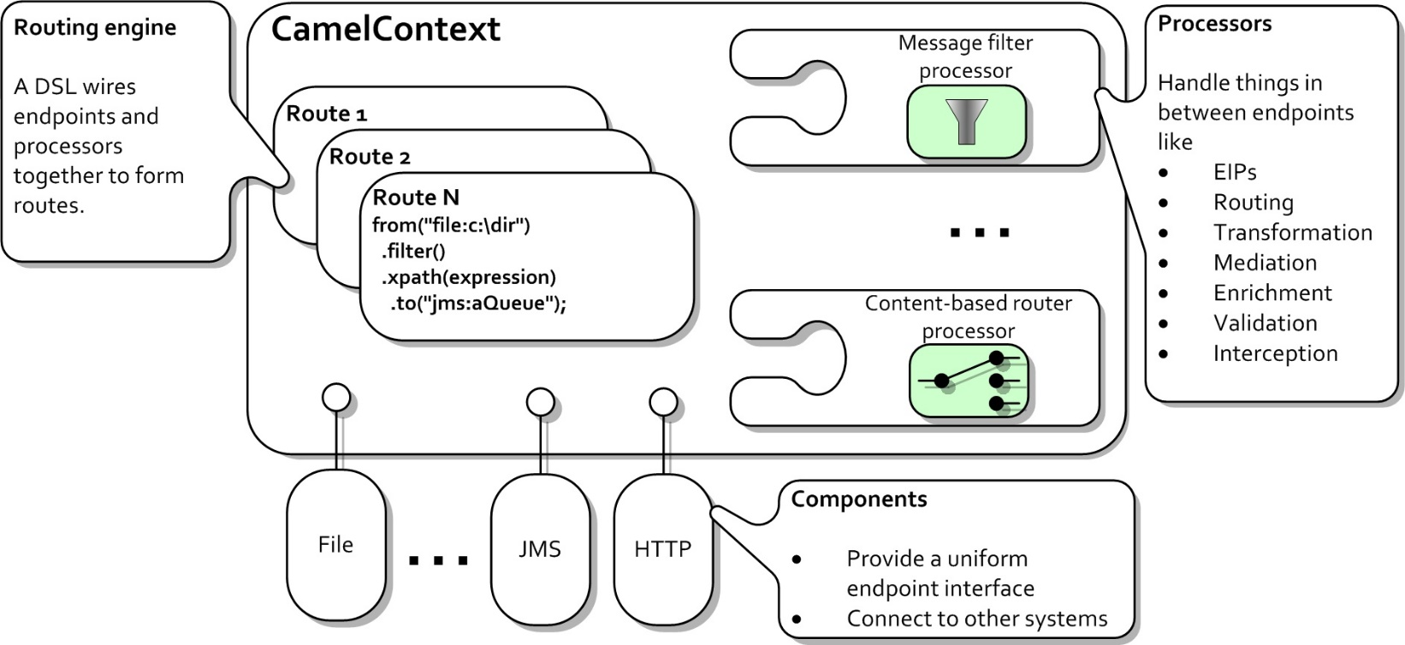

Slide 33
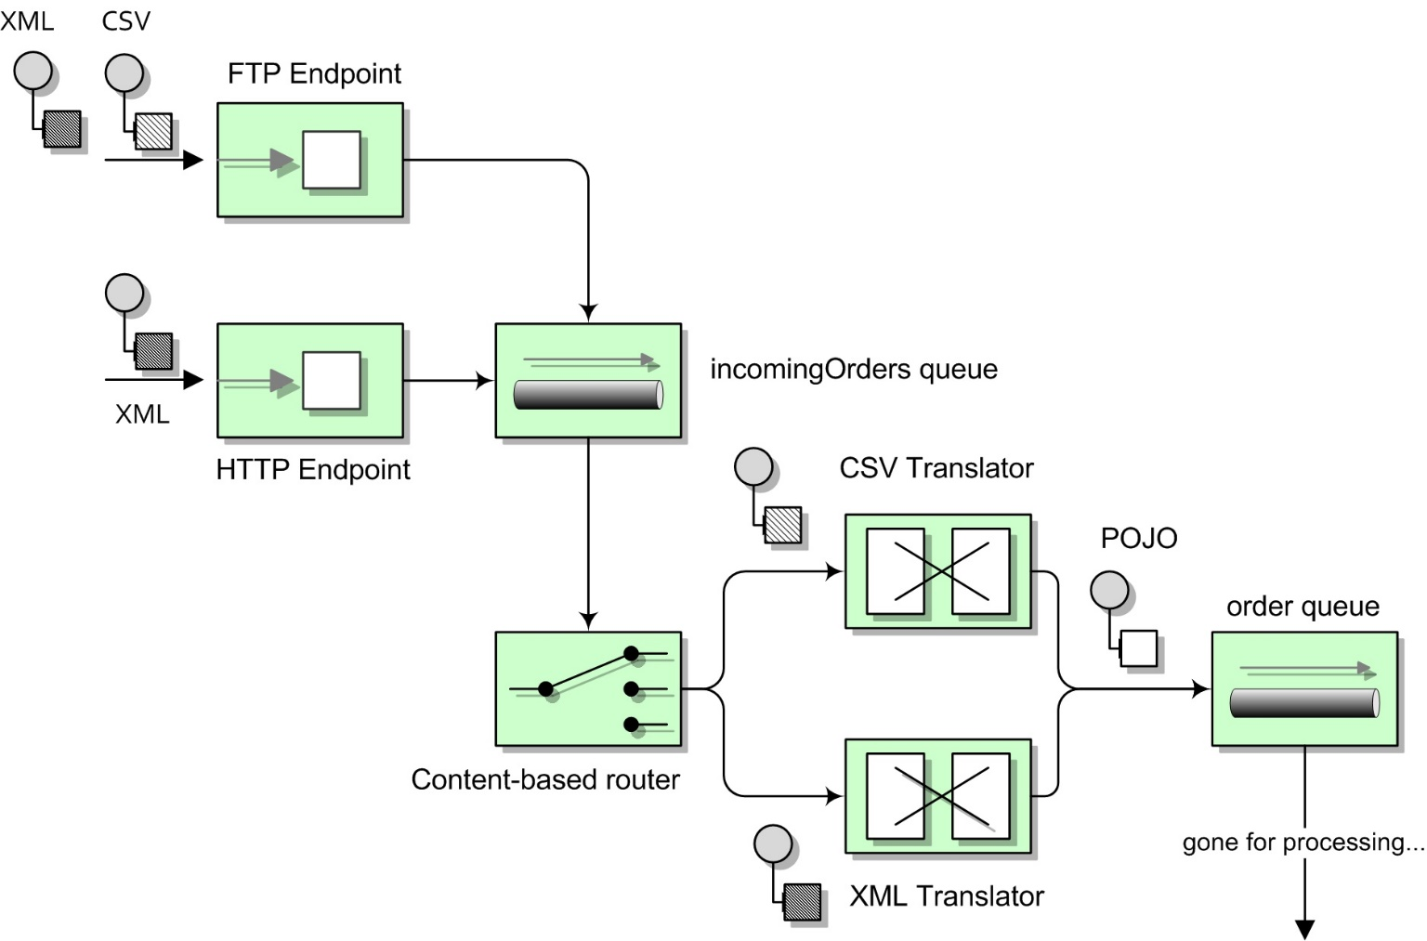

Slide 34
Exception Handling
<camelContext trace="false" id="camelContext"
xmlns="http://camel.apache.org/schema/spring">
<route> <from uri="file:/c:/temp"/>
<to uri="file:/c:/temp1"/>
<to uri="validator:file:c:/univ/EnrollmentInfo.xsd"/>
<onException>
<exception>org.apache.camel.ValidationException</exception>
<to uri="file:/c:/temp1/invalid"/>
</onException>
</route>
</camelContext>

Slide 35
Exception Handling
<camelContext trace="false" id="camelContext"
xmlns="http://camel.apache.org/schema/spring">
<route> <from uri="file:/c:/temp"/>
<to uri="file:/c:/temp1"/>
<to uri="validator:file:c:/univ/EnrollmentInfo.xsd"/>
<onException>
<exception>org.apache.camel.ValidationException</exception>
<to uri="file:/c:/temp1/invalid"/>
</onException>
</route>
</camelContext>

Slide 36
On Exception Retry
from("direct:universityEmail")
.onException(Exception.class)
.maximumRedeliveries(3)
.redeliveryDelay(5000)
.end()

Slide 37
Enterprise Integration
Patterns
●
Look at some of the EIPs available in
Camel
●
Goals and use cases
●
Implementation
Implementation
in
in
the
the
Java DSL
●
Spring
XML
DSL
●
Exercise
35/88

Slide 38
EIP: Pipeline
●
How can you build complex processing
from independent services?
●
use explicit <pipeline/> / pipeline()
but also happens by default in a route
●
●
Example: order processing requires
validation, stock
backordering
checking
and
36/88

Slide 39
EIP:
Pipeline
●
Example:
from("file:orders")
.to("direct:validation")
.to("direct:stock")
.to("direct:backorder");
from("file:orders")
.pipeline()
.to("direct:validation")
.to("direct:stock")
.to("direct:backorder");
<route>
<from uri="file:orders"/>
<to uri="direct:validation"/>
<to uri="direct:stock"/>
<to uri="direct:backorder"/>
</route>
<route>
<from uri="file:orders"/>
<pipeline>
<to uri="direct:validation"/>
<to uri="direct:stock"/>
<to uri="direct:backorder"/>
</pipeline>
</route>
37/88

Slide 40
EIP:
Message
Filter
●
How can you avoid receiving
uninteresting messages?
Example: only copy XML files from to dir/b
from("file:dir/a")
.filter(header(Exchange.FILE_NAME).endsWith(".xml"))
.to("file:dir/b");
●
dir/a
<route>
<from uri="file:dir/a"/>
<filter>
<simple>${file:name} contains 'xml'</simple>
<to uri="file:dir/b"/>
</filter>
</route>
38/88

Slide 41
Sidetrack: Languages
●
EIPs often require an
expression/predicate, which can
be
expressed in several
Languages
●
header, constant,
simple
xpath, xquery
OGNL
JSP EL
Scripting languages
●
●
●
●
●
like Ruby, Groovy,
...
● ...
39/88

Slide 42
EIP:
Content-based
router
●
How to route a
recipient based
Example: send
message to the correct
on the message content?
●
orders to specific
order
folder per customer language
from("file:orders")
.choice()
.when(xpath("/order/customer/@language
.to("file:orders/gd")
.when(xpath("/order/customer/@language
.to("file:orders/cy");
= 'gd'"))
= 'cy'"))
40/88

Slide 43
EIP: Content-based Router
●
Example: send orders to specific
folder per customer language
<route>
<from uri="file:orders"/>
<choice>
<when>
order
<xpath>/order/customer/@language
<to uri="file:orders/gd"/>
</when>
<when>
<xpath>/order/customer/@language
<to uri="file:orders/cy"/>
</when>
</choice>
</route>
=
'gd'</xpath>
=
'cy'</xpath>
41/88

Slide 44
EIP: Multicast
●
How to route the same message to
multiple recipients?
Example: order information is sent
●
to
accounting as
departement
well
as
fulfillment
42/88

Slide 45
EIP:
Multicast
●
Example:
from("direct:orders")
.multicast()
.to("direct:accounting")
.to("direct:fulfillment");
<route>
<from uri="direct:orders"/>
<multicast>
<to uri="direct:accounting"
/>
<to uri="direct:fulfillment" />
</multicast>
</route>
43/88

Slide 46
EIP: Wire Tap
●
How to inspect message that travel from
endpoint to the other?
●
Example: we want to
every order
from("file:orders")
.wireTap("file:audit/orders")
.to("direct:order");
keep
a
copy
of
<route>
<from uri="file:orders"/>
<wireTap uri="file:audit/orders"/>
<to uri="direct:order"/>
</route>
44/88

Slide 47
EIP:
Recipient
List
●
How to route a message to a list of
dynamically specified recipients?
●
This EIP can also
be
used
to
build
a
Dynamic
Router
45/88

Slide 48
EIP: Recipient List
●
Example: send orders to specific order
folder per customer language
from("file:orders")
.setHeader("language").xpath("/order/customer/@language")
.recipientList().simple("file:orders/${header.language}");
<route>
<from uri="file:orders"/>
<setHeader headerName="language">
<xpath>/order/customer/@language</xpath>
</setHeader>
<recipientList>
<simple>file:orders/${header.language}</simple>
</recipientList>
</route>
46/88

Slide 49
EIP: Splitter
●
How can we process a message that
contains multiple elements?
●
Example: a customer sends
containing multiple orders
from("file:orders")
.split().xpath("/orders/order")
.to("direct:order");
a
single
file
<route>
<from uri="file:orders"/>
<split>
<xpath>/orders/order</xpath>
<to uri="direct:order"/>
</split>
</route>
47/88

Slide 50
EIP:
Aggregator
●
How to combine several, related
messages into a single message?
Example: our customer now wants
●
a
single order
confirmation
file
for
the
order
file
she
sent
48/88

Slide 51
EIP:
Aggregator
●
AggregationStrategy required to combine
the exchanges
●
also used for multicast and recipient list
public class MyAggregationStrategy implements AggregationStrategy {
public Exchange aggregate(Exchange oldExchange, Exchange newExchange)
{
//
//
oldExchange contains the current aggregation result
newExchange is the new exchange to be added to the result
//
this would return the last Exchange as the final result
return newExchange;
}
}
49/88

Slide 52
Enterprise
integration
patterns
●
...and the list goes on
●
delay
enricher
idempotent consumer
loadbalance
loop
threads
throttle
...
●
●
●
●
●
●
●
50/88

Slide 53
Exercise
●
Use the EIPs to implement
●
read orders files from directory
split the orders file in separate orders make sure that we also have a copy of the
original file in an audit folder
●
●
●
drop any orders with a total quantity of
organize orders in separate folders by customer country
0
●
51/88

Slide 54
Planning
●
Introduction
Getting started EIPs in action Components in
●
with Camel
●
●
action
●
Beans
in
action
52/88

Slide 55
Components in action
●
Introduction
●
Using
components
examples
●
A
few
53/88

Slide 56
Introduction
DataSet
Direct
Esper
Event
Exec Browse Cache FTP
Cometd CXF CXFRS GLogin JavaSpace POP
Printer
Quartz
Smooks
GTask
GMail
HDFS
Hibernate
HL7
HTTP IMap
IRC JCR
Crypto JDBC File
Flatpack
Freemarker
SMTP
Restlet
RMI
FTPS
GAuth iBATIS
GHttp
ActiveMQ Journal
AMQP
Stream
Atom JBI Bean
Jetty
JMS SMPP
JPA Lucene
Mail
SFTP
Bean Validation
SNMP UDP
Spring- Integration
SQL StringTemplate
TCP SERVLET
Test
ActiveMQ Timer
Validation
JT/400
Velocity
VM
Quickfix
54/
88
RNC
RNG
Nagios
RSS
Scalate MSV XMPP Mock XQuery MINA XSLT Netty NMR SEDA
Ref LDAP Properties Log

Slide 57
Using
components
●
Add required JARs to the classpath
Add component to CamelContext
●
●
Auto-discovery
–
works for most of the components
uses files in component's JAR META-INF
–
folder
●
Manual
–
to have multiple instances of the same component
to configure the component before using it e.g. inject a JMS ConnectionFactory
–
55/88

Slide 58
Using
components
●
Example – register amq: component
●
Register in Java code
JmsComponent component = new JmsComponent();
component.setConnectionFactory(
new ActiveMQConnectionFactory("tcp://localhost:61616"));
context.addComponent("amq", component);
●
Register in Spring XML
<bean id="amq" class="org.apache.camel.component.jms.JmsComponent">
<property name="connectionFactory">
<bean class="org.apache.activemq.ActiveMQConnectionFactory">
<property name="brokerURL"
value="tcp://localhost:61616"/>
</bean>
</property>
</bean>
56/88

Slide 59
A few examples
●
File and FTP
Jetty
●
●
JMS and
Mail
Quartz
XSLT
ActiveMQ
●
●
●
57/88

Slide 60
File
and
FTP
●
Reading and writing files
●
on the local file system
on an FTP(S) server
●
●
Add to your project
●
file: component is part of camel-core.jar
ftp: component is in camel-ftp.jar both use auto-discovery
●
●
58/88

Slide 61
File
and
FTP
●
File URI format
●
file:directoryName or file://directoryName
e.g. file:/Users/gert/incoming
●
●
FTP URI format
●
ftp://[user@]host[:port]/directory
e.g. ftp://gert@www/public_html
●
●
Both of them have similar options
59/88

Slide 62
File and FTP
●
Selecting files
●
recursive
include
exclude
filter refers to
●
●
●
GenericFileFilter
●
sorter refers to Comparator<GenericFile>
from("file:local?recursive=true&include=.*html")
.to("ftp://www@www.anova.be/public_html");
60/88

Slide 63
File and FTP
●
Poller configuration
●
delete
move moveFailed noop preMove
●
●
●
●
from("file:orders?move=done&moveFailed=error")
61/88

Slide 64
File and FTP
●
Locking and concurrency
●
readLock:
markerFile, changed, fileLock,
idempotent
idempotentRepository
inProgressRepository
rename,
none
●
●
●
62/88

Slide 65
File
and
FTP
●
Writing files
●
File name
–
use message id
use Exchange.FILE_NAME header specify on endpoint
–
–
from("file:orders")
.setHeader(Exchange.FILE_NAME)
.simple("${file:name.noext}-${date:now:hhmmss}.${file:ext}")
.to("file:handled");
from("file:orders")
.to("file:handled?filename=${file:name}.done");
63/88

Slide 66
File and FTP
●
Other producer options
●
fileExist: Override,
tempPrefix tempFileName
Append,
Fail,
Ignore
●
●
64/88

Slide 67
JMS
and
ActiveMQ
●
Two JMS components
●
org.apache.camel:camel-jms
org.apache.activemq:activemq-camel
●
●
URI format
●
jms:[temp:|queue:|topic:]destinationName[?
options]
from("jms:incoming.orders")
.to("jms:topic:events")
.to("jms:queue:orders");
65/88

Slide 68
JMS
and
ActiveMQ
●
Message mapping
●
String, Node à TextMessage à String
Map à MapMessage à Map
Serializable à ObjectMessage à Object
●
●
●
byte[],
Reader,
InputStream à
BytesMessage à
byte[]
66/88

Slide 69
JMS and ActiveMQ
●
Some of the available options
●
transactions and acknowledgement
●
JMS priority, time to live and
durable subscriptions
delivery
mode
●
from("jms:incoming.orders?transacted=true")
.to("jms:topic:events?priority=7")
.to("jms:queue:orders?timeToLive=1000");
from("jms:topic:events?
clientId=camel&durableSubscriptionName=events")
.to("log:events");
67/88

Slide 70
Mail
●
camel-mail component supports
●
SMTP(S) for sending mails
IMAP(S)/POP(S) for receiving mails
●
●
URI format
●
imap://[username@]host[:port][?options]
pop3://[username@]host[:port][?options]
smtp://[username@]host[:port][?options]
●
●
68/88

Slide 71
Mail
●
Options for receiving mails
●
username/password
delete or mark as read folderName unseen=false to read all
●
●
●
messages
from("imap:server?username=user@server.com&
password=secret&unseen=false")
.to("log:full-inbox");
69/88

Slide 72
Mail
●
Options for sending mails
●
from, to, cc, bcc can be specified
or
set on the message as headers
on URI
from("file:orders")
.process(new Processor() {
public void process(Exchange exchange) throws Exception {
Map<String, Object> headers = exchange.getIn().getHeaders();
headers.put("To", "gert.vanthienen@gmail.com");
headers.put("Subject", "Order confirmation");
}
}).to("smtp:relay.skynet.be?from=gert.vanthienen@skynet.be");
70/88

Slide 73
Quartz
and
Timer
●
Two ways of scheduling tasks
●
timer: uses a simple Java Timer
–
simple
part of camel-core
–
●
quartz: uses Quartz
–
more options, e.g. cron-like expressions
–
component camel-quartz
from("timer:per-second?period=1000")
.to("log:seconds");
from("quartz:triggered?trigger.repeatCount=10
&trigger.repeatInterval=5000")
.to("log:quartz");
71/88

Slide 74
XSLT
●
Process messages with an XSLT template
●
template is used to convert body
access to headers by using <xsl:param/>s
●
●
URI
●
xslt:template[?options]
template can be on the http://
(Spring resource URI)
●
classpath, file:// or
72/88

Slide 75
XSLT
●
Example for using header as a parameter
from("direct:xsl")
.setHeader("timestamp").simple("${date:now:yyyyMMdd.hhss}")
.to("xslt:transform.xsl")
.to("log:result");
<xsl:stylesheet version="1.0" xmlns:xsl="...">
<xsl:param name="timestamp"/>
<xsl:template match="/">
<message>
<body>Message at <xsl:value-of select="$timestamp"/></body>
</message>
</xsl:template>
</xsl:stylesheet>
73/88

Slide 76
Exercise
●
Build a set of camel routes to
●
Generate
a message every 30 seconds
message to a file
file and it to the JMS queue
●
Write
Read
Read
the
the the
●
●
message from the JMS
queue
and
convert
it
to
a
nice
HTML
mail
74/88

Slide 77
Planning
●
Introduction
Getting started EIPs in action Components in
●
with Camel
●
●
action
●
Beans
in
action
75/88

Slide 78
Beans in action
●
Adding beans to your
Methods
route
●
●
Routing with
Exercise
beans
●
76/88

Slide 79
Adding
beans to
your
route
●
To access a bean in Camel
●
create the bean yourself in a Processor
create the bean in Spring
●
–
use @Autowired to automatically inject it
–
inject it into the router
yourself
DSL
in
Spring
●
use
the
bean/beanRef

Slide 80
Methods
●
Select method to invoke
●
CamelBeanMethodName
explicit method name on bean/beanRef()
@Handler annotation or other Camel annotations
method parameters
●
●
●
●
AmbiguousMethodCallException
to find a single best match
if unable

Slide 81
Adding
beans
to
your
route
●
In the Java DSL
●
use bean() with class/object
use beanRef() with bean name
●
OrderService orderService =
new
OrderService();
from("direct:order")
.bean(OrderService.class)
.bean(orderService)
.beanRef("orderService");

Slide 82
Adding
beans
to
your
route
●
In the Spring DSL
●
beanType for bean
ref for bean name
class
●
<route>
<from uri="direct:order"/>
<bean ref="orderService"/>
<bean beanType="be.anova.course.camel.OrderService"/>
</route>
<bean id="orderService" class="be.anova.course.camel.OrderService"/>

Slide 83
Adding
beans
to
your
route
●
Bean name is looked up in Registry
●
SimpleRegistry: for testing or GAE
JndiRegistry: uses JNDI (e.g. in appserver) ApplicationContextRegistry:
uses Spring ApplicationContext beans
OsgiServiceRegistry:
leverages OSGi Service Registry, using the Spring DM bean name
●
●
●

Slide 84
Methods
●
Select method to invoke
●
CamelBeanMethodName
explicit method name on bean/beanRef()
@Handler annotation or other Camel annotations
method parameters
●
●
●
●
AmbiguousMethodCallException
to find a single best match
if unable

Slide 85
Methods
●
Automatic binding
occurs
for
●
Exchange
Message CamelContext TypeConverter Registry Exception
●
●
●
●
●
public void handle(Exchange exchange,
Message message,
Exception exception){
// handle the exchange/message directly
}

Slide 86
Methods
●
Binding using annotations
●
@Body, @Header, @Headers
@OutHeader
@Property, @Properties
●
●
public void handle(@Header(Exchange.FILE_NAME)
@Body
String name,
String body)
{
System.out.printf("Handling file %s: %s", name, body);
}

Slide 87
Methods
●
Binding using annotations
●
Annotations for expression languages
@Bean, @BeanShell, @EL, @Groovy,
@JavaScript, @MVEL, @OGNL, @PHP,
●
@Python, @Ruby, @Simple, @XPath
@XQuery
and
public void handle(@Simple("${file:name}") String name,
@XPath("/order/customer/@id") String customer) { System.out.printf("Handling file %s for customer %s", name,
}
customer);

Slide 88
Routing
with beans
●
Only when using Spring
●
add bean to Spring XML file
add @Consume annotation to method
Camel bean post-processing will create
●
●
route
@Consume(uri="direct:order")
public void handle(@Simple("${file:name}") String name,
@XPath("/order/customer/@id") String customer) { System.out.printf("Handling file %s for customer %s", name, customer);
}

Slide 89
Exercise
●
Wire the OrderService into your route
●
3
–
methods
enrich() use Exchange as parameter and add timestamp header to the exchange
process() uses annotations to get parameter and message body
–
–
log() method uses @Consume
direct:log endpoint
to
read
from
the

Slide 90
Planning
●
Introduction
Getting started EIPs in action Components in
●
with Camel
●
●
action
●
Beans
in
action

Slide 91
What
else is
there?
●
There's a lot more in Camel
●
Interceptors and Tracer
OnCompletion
Error handling
JMX management
Transaction support
Testing support
Async API and threading
...
●
●
●
●
●
●
●

